Slide 1
Occupational Specialist Component Content: Digital Production, Design and Development
The T Level T Level Technical Qualification in Digital: Digital Production, Design and Development includes a single Occupational Specialist Component. Therefore, there is a single synoptic assessment for the Occupational Specialist Component, which is an extended ‘design, development and implementation’ project. The synoptic element of the project is important in order to ensure that students are able to demonstrate threshold competence: this is the principal reason why the Occupational Specialism is assessed via a single extended project assessment to ensure that students are able to evidence all the skills required by the Performance Outcomes.
The T Level Technical Qualification in Digital: Digital Production, Design and Development Occupational Specialist Component consists of several activities grouped into four substantive tasks.
Each task will be completed during a window set by Pearson during which you will schedule supervised assessment sessions. In some cases, tasks will also involve opportunities for unsupervised activities where the requirements of the skills being assessed make this necessary.

Slide 2
Learning Objectives
Aims:
To understand how to developing and testing a product
Objectives:
To be able to identify how to develop and test a product including:
Creating a prototype.
Plan and implement appropriate testing, including:
Module testing
System integration testing.
Automated testing
User testing and feedback.

Slide 3
Product Development and Testing
Product development and testing is the structured process of turning ideas into functional, high-quality products.
It includes designing, prototyping, coding, and conducting multiple layers of testing to ensure the product meets both functional requirements and user expectations.
The process is iterative and often incorporates continuous feedback for refinement.
Intent:
To ensure the product is fit for purpose, reliable, and user-friendly.
To identify and fix issues early in the development cycle, reducing costs and time-to-market.
To validate that all system components work individually (unit testing), collectively (integration testing), and in real-world usage scenarios (user testing).
To enable continuous improvement through automated testing and user feedback loops.
Tools used:
Agile tools (Scrum, Kanban boards)
Git/GitHub for version control
CI/CD for testing automation
Trello/Jira (project tracking)
Visual Studio Code, IntelliJ, etc. (IDE)

Slide 4
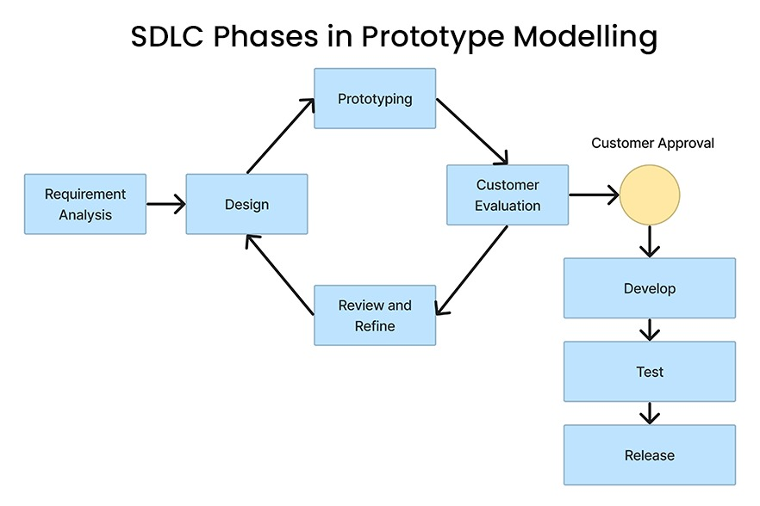
Creating a Prototype
Prototyping is the process of building a preliminary model of a product to validate ideas, design, and functionality before full-scale development.
Intent: To explore and validate product concepts quickly and cheaply, allowing teams to gather early feedback.
Tools used:
Figma, Adobe XD (UI/UX prototypes)
Sketch, Balsamiq (wireframes)
HTML/CSS/JavaScript (interactive web prototypes)

Slide 5
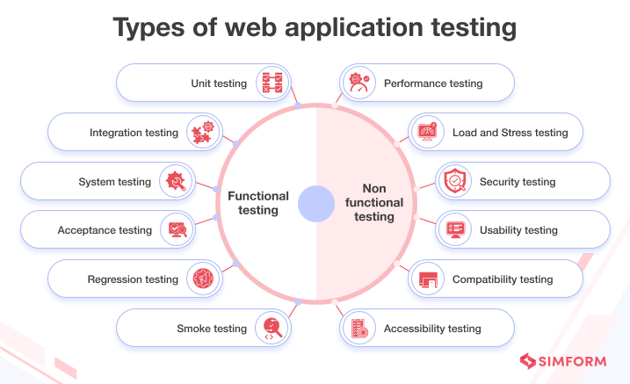
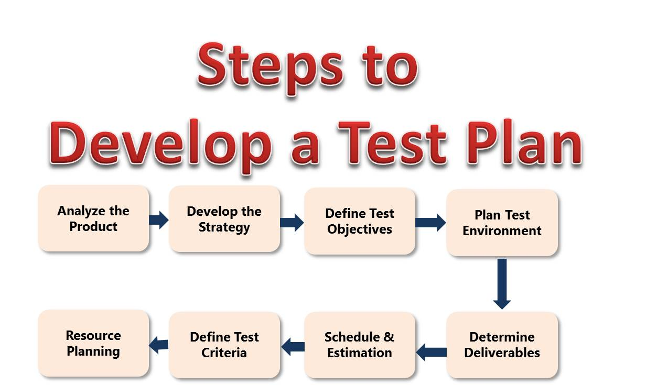
Planning the Testing Phases
Effective testing begins with a plan that outlines the scope, strategy, resources, and schedule for testing activities.
Intent: To ensure all components of the product are tested systematically, reducing risk and ensuring functionality.
Tools used:
TestRail (test case management)
Confluence (test plan documentation)
Excel/Google Sheets (simple test tracking)

Slide 6
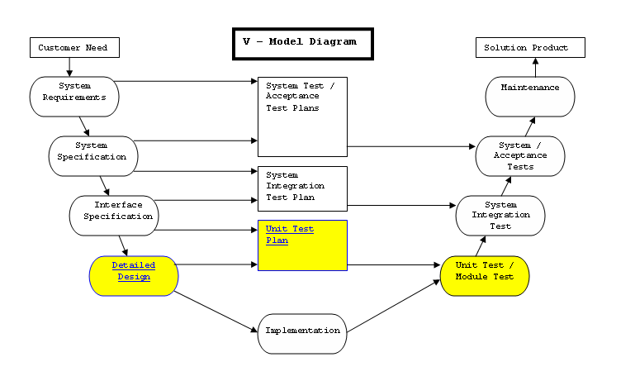

Module Testing (Unit Testing)
Testing individual components or modules in isolation to verify that each works correctly.
Intent: To catch bugs early by testing small units of code during development.
Tools used:
JUnit (Java)
NUnit (C#)
PyTest (Python)
Mocha/Chai (JavaScript)
Notes:
https://www.dotnetcurry.com/aspnet-mvc/981/unit-testing-aspnet-mvc-nunit-visual-studio
https://learn.microsoft.com/en-us/visualstudio/test/getting-started-with-unit-testing?view=vs-2022&tabs=dotnet%2Cmstest
https://www.youtube.com/watch?v=TGq-gY672_k

Slide 7
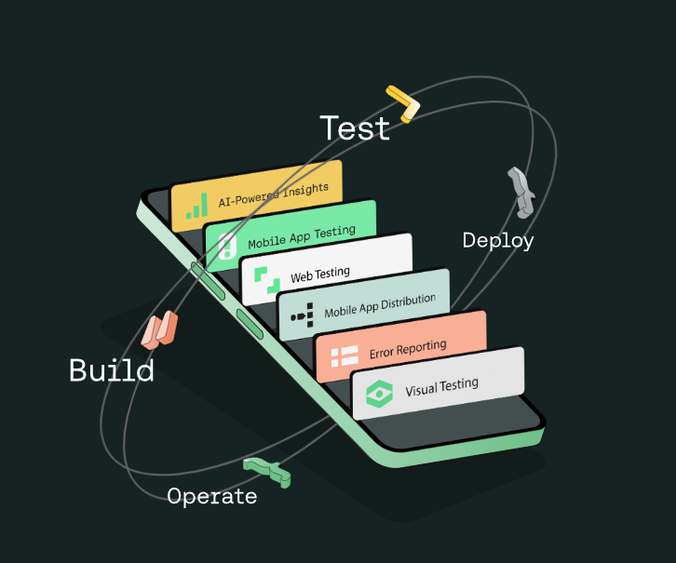
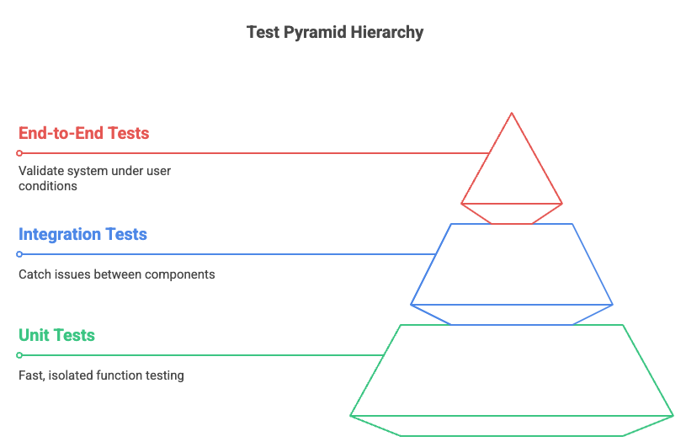
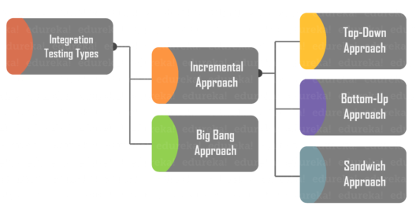
System Integration Testing
Tests how modules interact together as a complete system, validating data flow and integration between services.
Intent: To identify interface defects and communication failures between modules and subsystems.
Common Scenarios:
API Integration Between Frontend and Backend
Database and Backend Communication
Third-Party Service Integrations
Microservices Communication
Authentication & Authorization Workflows
Tools used:
Postman (API testing)
Selenium (web app testing)
SoapUI (web services)
Notes:
https://saucelabs.com/
https://www.browserstack.com/guide/integration-testing
Common Scenarios Where Integration Testing is Used:
1. API Integration Between Frontend and Backend
Use Case: When a frontend web/mobile app consumes data from a backend API.
Example: After logging in, the frontend sends user credentials to the /auth/login API. Integration testing ensures:
The API responds with the correct user token.
The frontend correctly processes and stores that token.
Tools: Postman, RestAssured, Jest (with fetch/axios mocking)
2. Database and Backend Communication
Use Case: When your backend reads or writes to a database.
Example: A POST /orders API endpoint saves data to a SQL or NoSQL database. Integration testing confirms:
Data is stored correctly.
The backend handles DB errors properly.
Tools: TestContainers, Sequelize test harnesses, in-memory DBs like SQLite
3. Third-Party Service Integrations
Use Case: Your app uses external APIs (e.g., payment gateways, email services).
Example: An e-commerce app processes payments via the Stripe API. Integration testing checks:
Payment requests are sent correctly.
Responses (e.g., success, declined) are handled appropriately.
Tools: Mock servers, WireMock, Mockito (for Java)
4. Microservices Communication
Use Case: Multiple microservices need to interact over REST, gRPC, or messaging (e.g., Kafka).
Example: A shopping cart service queries a product service to fetch item details. Integration tests ensure:
The communication protocol works.
The response format is valid and handled correctly.
Tools: Docker Compose (to run services together), Pact (for contract testing)
5. Authentication & Authorization Workflows
Use Case: Secure areas of your app require a login.
Example: A test logs in via the /login API, then uses the token to access /dashboard. Integration tests validate:
Tokens are correctly issued and validated.
Access control rules are enforced.
Tools: Postman collections, Playwright/Cypress with login flows

Slide 8
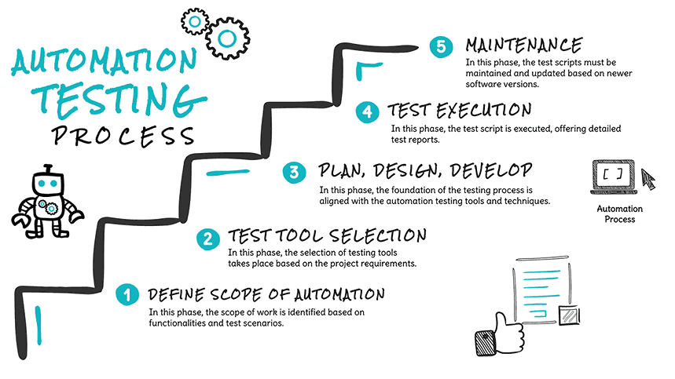
Automated Testing
Automated testing involves writing scripts to automatically run tests, reducing manual effort and improving test coverage.
Intent: To increase efficiency, consistency, and speed in the testing process.
Common Scenarios:
Regression testing
Smoke Testing (Build Verification Testing)
Unit Testing
API Testing
Cross-Browser / Cross-Platform UI Testing
Performance and Load Testing
End-to-End (E2E) Testing
Data Validation Testing
Scheduled or Nightly Builds
Tools used:
Selenium, Cypress (UI automation)
Jenkins, GitHub Actions (CI/CD pipelines)
TestNG, JUnit (test frameworks)
Notes:
Common Scenarios for Automated Testing
Automated testing is ideal for repetitive, predictable, and time-consuming testing tasks. Below are the most common scenarios where automation adds real value:
🔹 1. Regression Testing
Purpose: Ensure that new code changes do not break existing functionality.
Example: After adding a new user role, automatically test all login and permission features to confirm nothing broke.
Tools: Selenium, JUnit, TestNG, Cypress
🔹 2. Smoke Testing (Build Verification Testing)
Purpose: Quickly verify that the basic features of the app work after a new build or deployment.
Example: Test that the application loads, login works, and key menus appear.
Tools: Jenkins (CI), Playwright, Cypress
🔹 3. Unit Testing
Purpose: Test individual functions or methods in isolation.
Example: Automatically test that a function calculating order totals returns the correct value.
Tools: PyTest (Python), JUnit (Java), NUnit (C#), Jest (JavaScript)
🔹 4. API Testing
Purpose: Validate RESTful or GraphQL APIs for correct response, status codes, performance, and errors.
Example: Automatically test that /api/products returns the correct list and handles missing parameters gracefully.
Tools: Postman (with Newman), RestAssured, Karate, Insomnia
🔹 5. Cross-Browser / Cross-Platform UI Testing
Purpose: Ensure your web app looks and behaves the same across browsers and devices.
Example: Automated UI tests simulate user actions on Chrome, Firefox, Safari, etc.
Tools: Selenium Grid, BrowserStack, Playwright
🔹 6. Performance and Load Testing
Purpose: Check how the system behaves under heavy load or stress.
Example: Simulate 500 users logging in simultaneously and verify system stability.
Tools: JMeter, Locust, Gatling, k6
🔹 7. End-to-End (E2E) Testing
Purpose: Test the entire workflow from start to finish to simulate real user scenarios.
Example: Sign up → Browse products → Add to cart → Checkout → Receive order confirmation.
Tools: Cypress, Playwright, Selenium, Puppeteer
🔹 8. Data Validation Testing
Purpose: Ensure that data integrity is maintained when transferred between systems or stored in databases.
Example: Verify that a user’s form data is correctly saved to and retrieved from the database.
Tools: DBUnit, SQL assertions in test scripts
🔹 9. Scheduled or Nightly Builds
Purpose: Automatically run full test suites overnight or on a schedule to catch issues early.
Example: A test job runs every night and emails the team if any tests fail.
Tools: Jenkins, GitHub Actions, GitLab CI/CD
CI/CD Explained:
CI (Continuous Integration): A development practice where developers frequently integrate code into a shared repository, often multiple times a day. Each integration is verified by automated tests to detect issues early.
CD (Continuous Delivery/Deployment):
Continuous Delivery ensures that code changes are automatically prepared for release to a testing or staging environment.
Continuous Deployment goes further by automatically deploying every change that passes the tests directly to production.
🔹 CI/CD for Testing Automation:
CI/CD pipelines integrate automated testing at every stage of the software development lifecycle. This includes:
Triggering Tests Automatically: Whenever new code is pushed, tests are automatically run to check for regressions, integration issues, or performance problems.
Types of Tests in CI/CD Pipelines:
Unit Tests – Check individual functions or modules.
Integration Tests – Verify interaction between components.
UI/End-to-End Tests – Simulate user interactions and workflows.
Performance Tests – Monitor speed, responsiveness, and stability.
Feedback Loop: Developers get immediate feedback if their changes break something, which helps maintain code quality and speed up development.

Slide 9
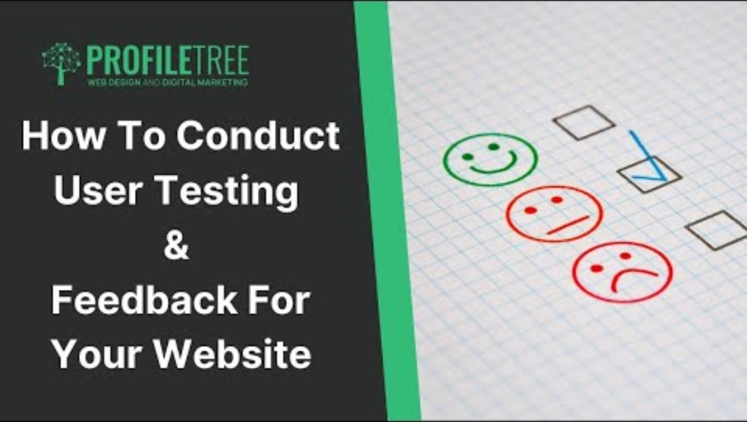
User Testing and Feedback
Engaging real users to test the product in realistic scenarios to gather feedback on usability, functionality, and overall satisfaction.
Intent: To ensure the product meets user expectations and identify potential improvements before launch.
Common Scenarios:
Usability Testing
Beta Testing
A/B Testing
Surveys and Feedback Forms
In-App Feedback
Customer Support & Helpdesk Insights
Session Recording & Heatmaps
Feature Validation or Preference Testing
Tools used:
Google Forms, Microsoft Forms, Typeform (feedback collection)
UsabilityHub, Maze (user testing platforms)
Session recording tools (e.g., Hotjar)
Notes:
https://trymata.com/blog/types-of-user-feedback/
Common Scenarios for User Testing and Feedback
User testing and feedback focus on how real users interact with your product to identify usability issues, gaps in functionality, or unclear workflows. It's essential for building a user-centered product that actually solves problems.
🔹 1. Usability Testing
Purpose: Observe how easily users can complete tasks.
Example: Ask users to sign up, browse products, and complete a checkout. Watch where they struggle or hesitate.
Feedback Goal: Identify confusing navigation, unclear labels, or poor layout.
Tools: Maze, Lookback, UserTesting.com, in-person observation
🔹 2. Beta Testing
Purpose: Provide early access to a limited group of users before the public release.
Example: Release a beta version of a mobile app to 100 users to find bugs and usability issues.
Feedback Goal: Collect bug reports, feature requests, and general user satisfaction.
Tools: TestFlight (iOS), Google Play Console (Android), Discord, Slack channels for feedback
🔹 3. A/B Testing
Purpose: Compare two versions of a feature to see which performs better with users.
Example: Test two different signup button designs to see which gets more clicks.
Feedback Goal: Measure user behavior (conversion, engagement) and preference.
Tools: Google Optimize, Optimizely, VWO, Mixpanel
🔹 4. Surveys and Feedback Forms
Purpose: Collect direct, qualitative feedback from users after using the product.
Example: Send a survey after onboarding asking, “Was anything confusing or missing?”
Feedback Goal: Discover pain points, desired features, or satisfaction ratings.
Tools: Google Forms, Typeform, SurveyMonkey
🔹 5. In-App Feedback
Purpose: Let users leave feedback while they’re using the app.
Example: A floating “Feedback” button allows users to report bugs or suggest features instantly.
Feedback Goal: Get contextual feedback from real usage scenarios.
Tools: Hotjar, Instabug, Usersnap
🔹 6. Customer Support & Helpdesk Insights
Purpose: Analyze support tickets and chat logs to find recurring issues.
Example: Many users contact support saying they can’t find the billing page — that’s a UX problem.
Feedback Goal: Identify common problems users experience and adjust the design or documentation.
Tools: Zendesk, Intercom, Freshdesk
🔹 7. Session Recording & Heatmaps
Purpose: Track where users click, scroll, or abandon tasks.
Example: Heatmaps show users aren’t scrolling past the fold on your homepage.
Feedback Goal: Visualize user behavior to improve layout and content.
Tools: Hotjar, FullStory, Crazy Egg
🔹 8. Feature Validation or Preference Testing
Purpose: Test early feature ideas or mockups before investing in development.
Example: Show users two dashboard mockups and ask which they prefer.
Feedback Goal: Validate assumptions and guide design choices.
Tools: Figma prototypes, UsabilityHub, InVision

Slide 10

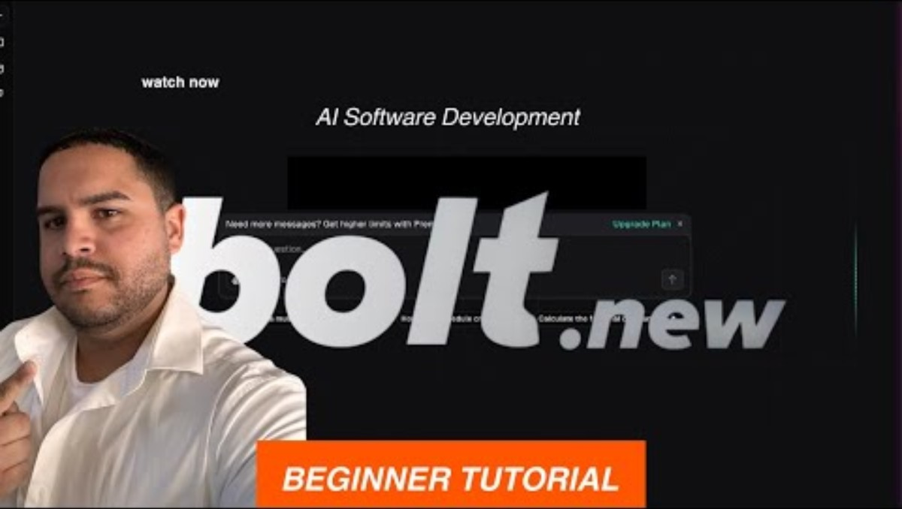

Activity – Build, Test and Improve
Objective: To simulate the process of developing and testing a product through a hands-on, team-based project.
You Will Learn To:
Design a prototype based on user needs
Plan and run unit, integration, and user tests
Use feedback to improve your product
How It Works:
Work in teams of 3–5
Choose or receive a simple product idea
Build a basic prototype
Test it thoroughly (unit, integration, and user)
Improve based on feedback
Present your work and share lessons learned
Notes:
https://www.youtube.com/watch?v=8jH0mvGyZa4
5 Best APP Builders For Beginners In 2025 (No-Code + AI)
https://www.youtube.com/watch?v=EXajQaw0tWI

